Slide 1

Operating System
LEC1: INTRODUCTION

Slide 2
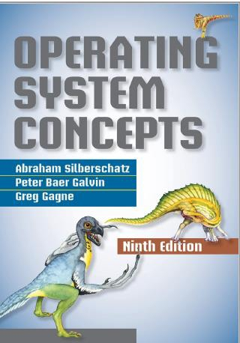
Reference

Slide 3
Topics to be covered
➢Introduction to operating system
➢Process Management
➢CPU scheduling
➢Deadlocks
➢Memory Management
➢I/O Systems
➢Protection and security

Slide 4

What is Operating
System?

Slide 5
What is an Operating System?
➢A program that acts as an intermediary between a user of a computer and the computer
hardware
➢Operating system goals:
➢Execute user programs and make solving user problems easier
➢Make the computer system convenient to use
➢Use the computer hardware in an efficient manner
➢“The one program running at all times on the computer” is the kernel.
➢Everything else is either
➢a system program (ships with the operating system) , or
➢an application program.

Slide 6
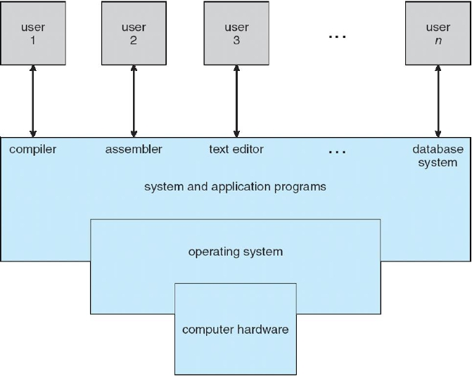
ComputerSystem Structure

Slide 7
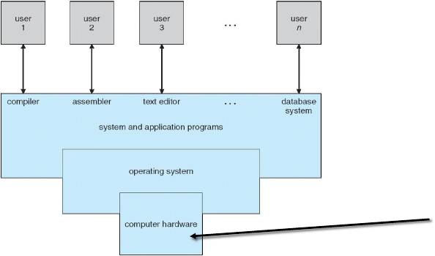
Computer System Structure
provides basic computing resources
CPU, memory, I/O devices

Slide 8
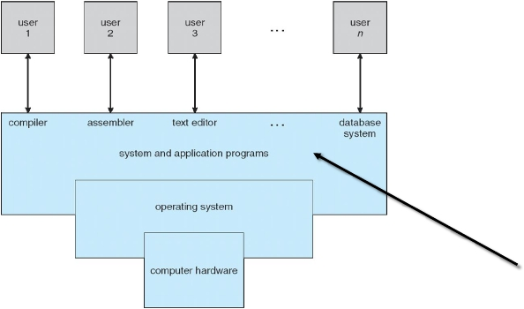
Computer System Structure
define the ways in which the system resources are
used to solve the computing problems of the users
Word processors, compilers, web browsers,
database systems, video games

Slide 9
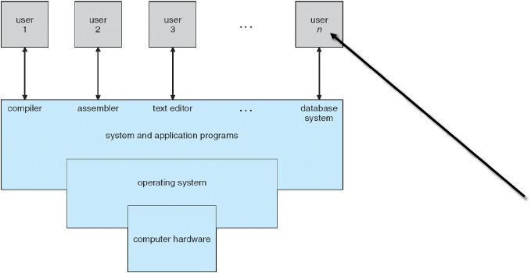
Computer System Structure
People, machines, other computers

Slide 10
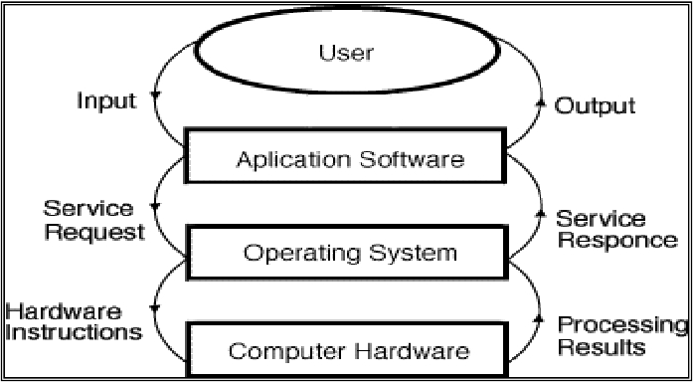
Dynamic View of System Components

Slide 11
ServicesProvidedbyOperatingSystems
Program execution.
I/O operations.
File-system manipulation
Communications.
Error detection.
Resource allocation.
Accounting.
Protection and security.
1.
2.
3.
4.
5.
6.
7.
8.

Slide 12
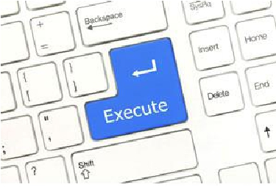
ServicesProvidedbyOperatingSystems
Program execution.
◦ The system must be able to load a program into memory and to run that program.
◦ The program must be able to end its execution, either normally or abnormally (indicating error).
I/O operations.
File-system manipulation
Communications.
Error detection.
Resource allocation.
Accounting.
Protection and security.
1.
2.
3.
4.
5.
6.
7.
8.

Slide 13
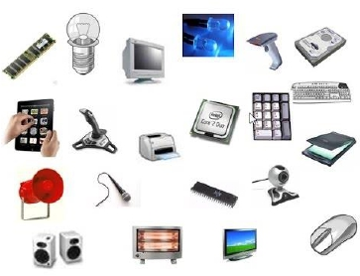
ServicesProvidedbyOperatingSystems
Program execution.
I/O operations.
◦ A running program may require I/O, which may involve a file or an I/O device.
◦ For efficiency and protection, users usually cannot control I/O devices directly.
◦ Therefore, the operating system must provide a means to do I/O.
File-system manipulation
Communications.
Error detection.
Resource allocation.
Accounting.
Protection and security.
1.
2.
3.
4.
5.
6.
7.
8.

Slide 14
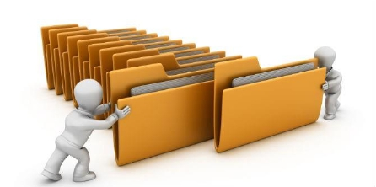
ServicesProvidedbyOperatingSystems
Program execution.
I/O operations
File-system manipulation.
◦ programs need to read and write files and directories. They also need to create and delete them by name,
search for a given file, and list file information.
◦ some operating systems include permissions management to allow or deny access to files or directories
based on file ownership.
Communications.
Error detection.
Resource allocation.
Accounting.
Protection and security.
1.
2.
3.
4.
5.
6.
7.
8.

Slide 15

ServicesProvidedbyOperatingSystems
Program execution.
I/O operations.
File-system manipulation.
Communications.
◦ one process may need to exchange information with another process.
◦ Such communication may occur between processes on the same computer or between processes on
different computer systems tied together by a computer network.
◦ Communications may be implemented via shared memory, in which two or more processes read and write
to a shared section of memory, or message passing, in which packets of information in predefined formats
are moved between processes by the operating system.
Error detection.
Resource allocation.
Accounting.
Protection and security.
1.
2.
3.
4.
5.
6.
7.
8.

Slide 16

ServicesProvidedbyOperatingSystems
Program execution.
I/O operations.
File-system manipulation.
Communications.
Error detection.
◦ The operating system needs to be detecting and correcting errors constantly.
◦ Errors may occur:
◦ in the CPU and memory hardware (such as a memory error or a power failure),
◦ in I/O devices (such as a parity error on disk, a connection failure on a network, or lack of paper in the printer),
◦ in the user program (such as an arithmetic overflow, an attempt to access an illegal memory location, or a too-great use
of CPU time).
◦ For each type of error, the operating system should take the appropriate action to ensure correct and
consistent computing.
Resource allocation.
Accounting.
Protection and security.
1.
2.
3.
4.
5.
6.
7.
8.

Slide 17

ServicesProvidedbyOperatingSystems
Program execution.
I/O operations.
File-system manipulation.
Communications.
Error detection.
Resource allocation.
◦ When there are multiple users or multiple jobs running at the same time, resources must be allocated to
each of them.
◦ The operating system manages many different types of resources.
Accounting.
Protection and security.
1.
2.
3.
4.
5.
6.
7.
8.

Slide 18

ServicesProvidedbyOperatingSystems
Program execution.
I/O operations.
File-system manipulation.
Communications.
Error detection.
Resource allocation.
Accounting.
◦ We want to keep track of which users use how much and what kinds of computer resources.
Protection and security.
1.
2.
3.
4.
5.
6.
7.
8.

Slide 19

ServicesProvidedbyOperatingSystems
Program execution.
I/O operations.
File-system manipulation.
Communications.
Error detection.
Resource allocation.
Accounting.
Protection and security.
◦ Protection involves ensuring that all access to system resources is controlled.
◦ Security of the system from outsiders is also important.
◦ each user to authenticatehimself or herself to the system to gain access to system resources. It extends to
◦ defending external I/O devices, including network adapters, from invalid access attempts and to recording all such
connections for detection of break-ins.
1.
2.
3.
4.
5.
6.
7.
8.

Slide 20
Historical overview
➢Mainframe system: the first computer used to tackle many
commercial and scientific applications
➢Batch systems
➢Multiprogrammed systems
➢Time-Sharing Systems
➢Personal-Computer Systems
➢Multiprocessor Systems (parallel system)
➢Distributed System

Slide 21
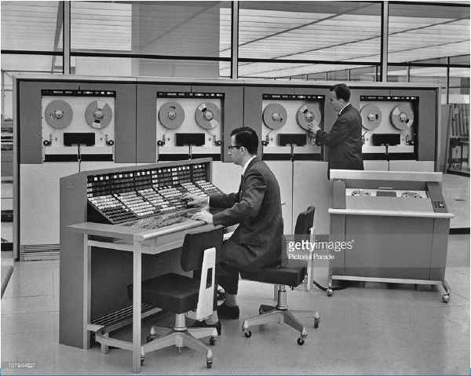
Mainframe system

Slide 22
Historical overview
Mainframe system:
◦ Batch systems:
◦
◦
◦
◦
◦
Physically enormous machines run from a console
The common input devices were card readers and tape drivers
The common output devices were line printers, tape drivers and card punches
The user didn’t interact directly with the computer system
The user prepared a job in the form of punch cards (program, data control information) and submit it
to the computer operator
◦ The output consists of results of the program, dump of the final memory and the register content for
debugging
◦ The operating system was simple, it transfer control automatically from one job to another.
◦ To speed up processing operators batched together jobs with similar needs and run them through
computers as a group

Slide 23
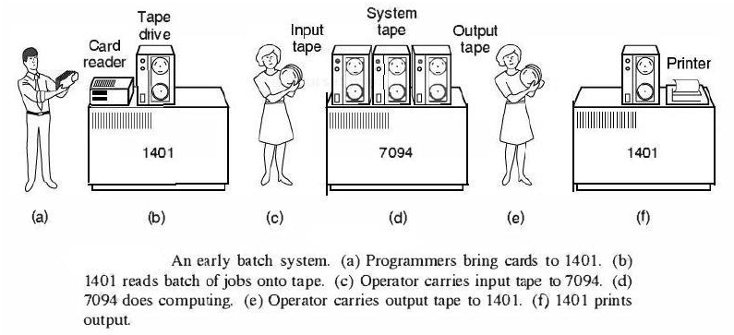

Slide 24
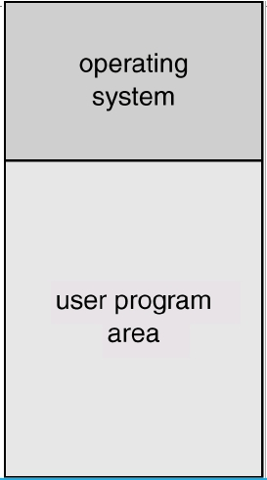
MemoryLayout for a Simple Batch
System

Slide 25
Historical overview
Mainframe system:
◦ Multiprogrammed systems:
◦ Several jobs are kept in main memory at the same time, and the CPU is multiplexed among them.
◦ The operating system picks and begins to execute one of the jobs in the memory, if the job waits for
some task (ex: I/O operations) the operating system switches to another job.

Slide 26
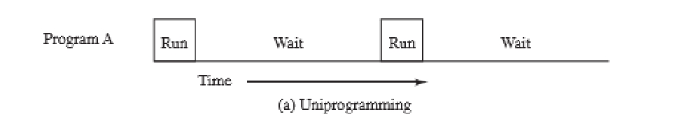
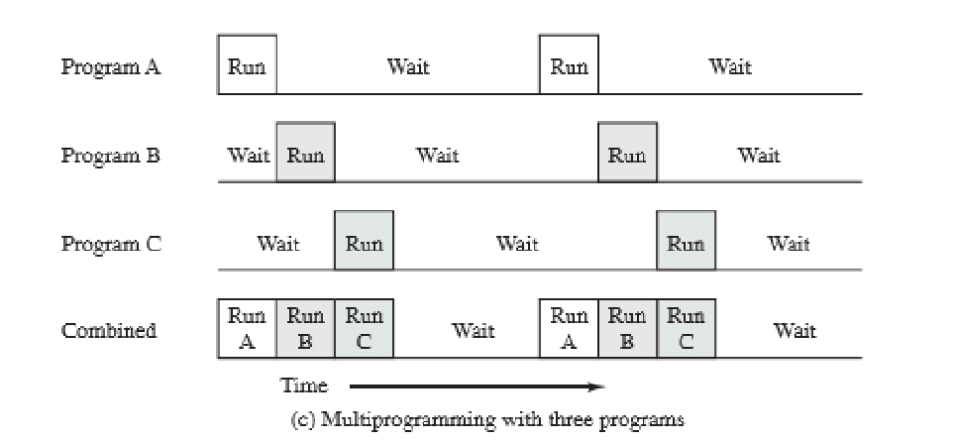

Slide 27
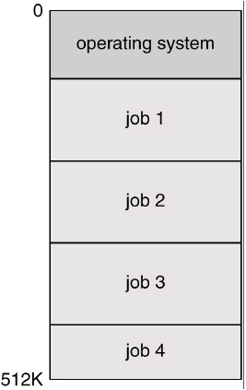
M emory Layout for Multiprogrammed Systems

Slide 28
Historical overview
Mainframe system:
◦ Time-Sharing Systems:
◦ A logical extension of multiprogramming
◦ The CPU executes multiple jobs by switching among them, but switch occur so frequently that the
user can interact with each program while it is running
◦ It provides direct communication between the user and the system using a mouse or a keyboard
◦ It allows more than one user to share the computer simultaneously

Slide 29
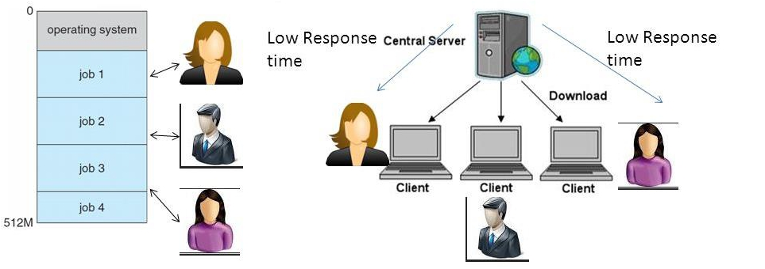

Slide 30
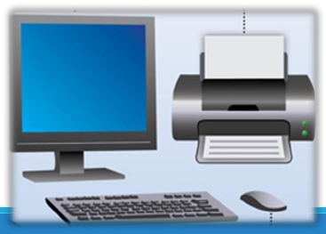
Historical overview
Personal computers – computer system
◦
◦
◦
◦
computer system dedicated to a single user.
I/O devices – keyboards, mice, display screens, small printers.
User convenience and responsiveness.
Can adopt technology developed for larger operating system’ often individuals have sole
use of computer and do not need advanced CPU utilization of protection features.

Slide 31
Historical overview
Multiprocessor Systems (parallel system)
◦ Multiprocessor systems with more than one CPU in close communication.
◦ Tightly coupled system – processors share memory and a clock; communication
usually takes place through the shared memory.
◦ Advantages of parallel system:
◦ Increased throughput: more work is done in less time
◦ Economical: save money than multiple single processor system as they share peripherals, mass storage
and power supplies
◦ Increased reliability: failure of one processor will not halt the system

Slide 32
Historical overview
Multiprocessor Systems (parallel system)
◦ Symmetric multiprocessing (SMP)
◦ Each processor runs an identical copy of the operating system.
◦ Many processes can run at once without performance deterioration.
◦ Most modern operating systems support SMP
◦ Asymmetric multiprocessing
◦ Each processor is assigned a specific task; master processor schedules and allocates work to slave
processors.
◦ More common in extremely large systems

Slide 33
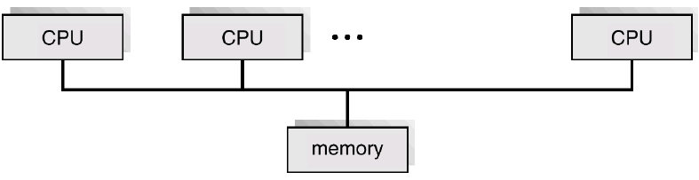
Symmetric Multiprocessing Architecture

Slide 34
Historical overview
Distributed System
◦ Distribute the computation among several physical processors.
◦ Loosely coupled system – each processor has its own local memory; processors
communicate with one another through various communications lines, such as high-
speed buses or telephone lines.
◦ Advantages of distributed systems.
◦
◦
◦
◦
Resources Sharing
Computation speed up – load sharing
Reliability
Communications

Slide 35
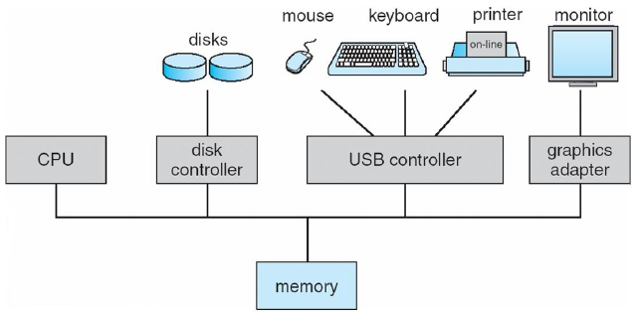
Computer System Organization
Computer-system operation
◦ One or more CPUs, device controllers connect through common bus providing access to shared memory
◦ Concurrent execution of CPUs and devices competing for memory cycles

Slide 36
Computer-System Operation
➢I/O devices and the CPU can execute concurrently
➢Each device controller is in charge of a particular device type
➢Each device controller has a local buffer
➢CPU moves data from/to main memory to/from local buffers
➢I/O is from the device to local buffer of controller
➢Device controller informs CPU that it has finished its operation by causing an interrupt

Slide 37
Common Functions of Interrupts
➢Interrupt transfers control to the interrupt service routine generally, through the interrupt
vector, which contains the addresses of all the service routines
➢Interrupt architecture must save the address of the interrupted instruction
➢Hardware may trigger an interrupt at any time sending a signal to the CPU.
➢Software may trigger an interrupt executing a special operation called a system call.

Slide 38
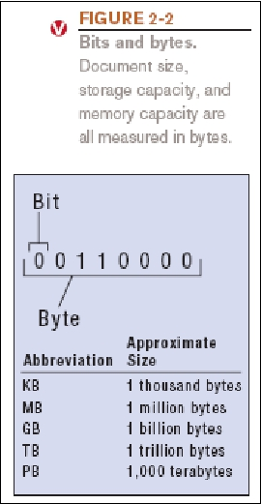
Digital Data Representation
➢Bit: The smallest unit of data that a binary
computer can recognize (a single 1 or 0)
➢ Byte = 8 bits
➢ Byte terminology used to express the size of documents and
other files, programs, etc.
38

Slide 39
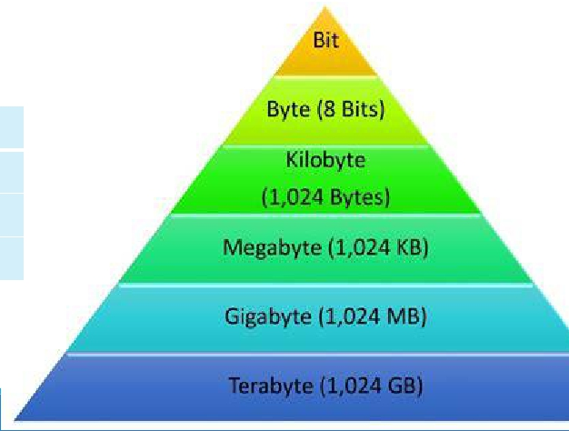
Digital Data Representation
➢Prefixes are often used to express larger quantities of
bytes: kilobyte (KB), megabyte (MB), gigabyte (GB),
terabyte (TB), petabyte (PB), exabyte (EB), zettabyte
(ZB), yottabyte (YB).
1Kilobytes(KB) | 10 2bytes | 1024bytes
1Megabytes(MG) | 20 2bytes | 1024KB
1Gegabytes(GB) | 30 2bytes | 1024MB
1Terabytes(TB) | 40 2bytes | 1024GB

Slide 40
Storage Hierarchy
➢Storage systems organized in hierarchy
➢Speed
➢Cost
➢Volatility
➢Caching – copying information into faster storage system; main memory can be
viewed as a cache for secondary storage
➢Device Driver for each device controller to manage I/O
➢Provides uniform interface between controller and kernel

Slide 41
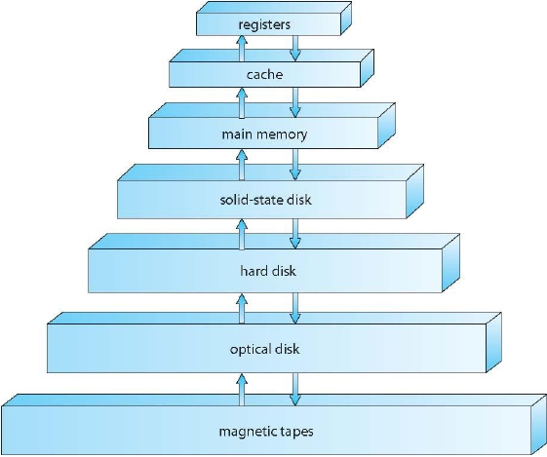
Storage-DeviceHierarchy

Slide 42
Storage Structure
➢Main memory – only large storage media that the CPU can access directly
➢Random access
➢Typically volatile
➢Secondary storage – extension of main memory that provides largenonvolatile storage
capacity
➢Hard disks – rigid metal or glass platters covered with magnetic recording material
➢Disk surface is logically divided into tracks, which are subdivided into sectors
➢The disk controller determines the logical interaction between the device and the computer
➢Solid-state disks – faster than hard disks, nonvolatile
➢Various technologies
➢Becoming more popular

Slide 43
Caching
➢Important principle, performed at many levels in a computer (in hardware, operating system,
software)
➢Information in use copied from slower to faster storage temporarily
➢Faster storage (cache) checked first to determine if information is there
➢If it is, information used directly from the cache (fast)
➢If not, data copied to cache and used there
➢Cache smaller than storage being cached
➢Cache management important design problem
➢Cache size and replacement policy

